Slide 1
ME447 Project3 Slithering-Wiggling-Snake
Raymond Huang
Armaan Mehta
Holiday Han

Slide 2
Table Of Content
Project 3 Objective
Snake force implementation
CMA input implementation
CMA Results Plot and video for pure wiggling
CMA Results Plot and video for pure twitching
CMA Results Plot and video for combined case

Slide 3
Project 3 Objective
After implemented the computational soft mechanics code and construct a near-realistic model of a slithering snake and hooked it up to CMA to find a gait that maximizes the forward speed, under given conditions in project 2, we want to have a more real-life soft mechanics model based on the snake we have already had.
This project is created for studying the effect of wiggling in snake gaits. In real life situations, when a snake moves, it does not only slither due to movements created by muscle torque, it also extends and shrinks, what we called wiggle. We want to hook the entire things up with CMA to find which combination of wiggling and slithering maximizes the forward speed? That is what we are studying in this project.

Slide 4
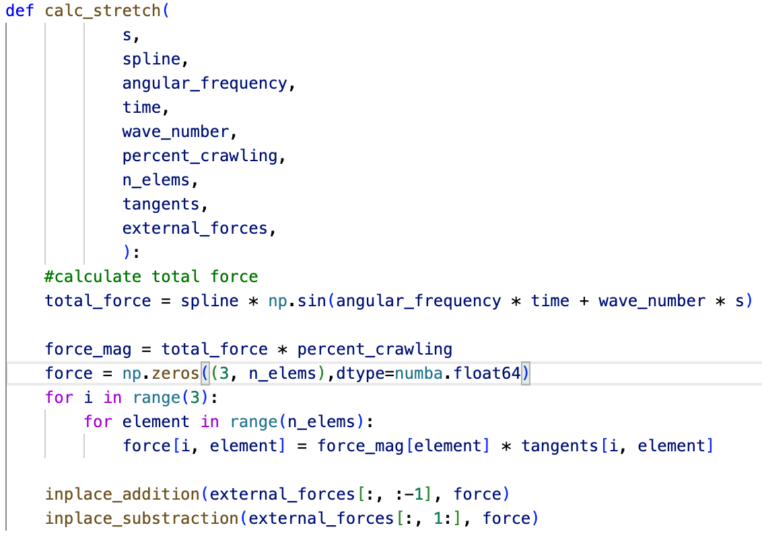
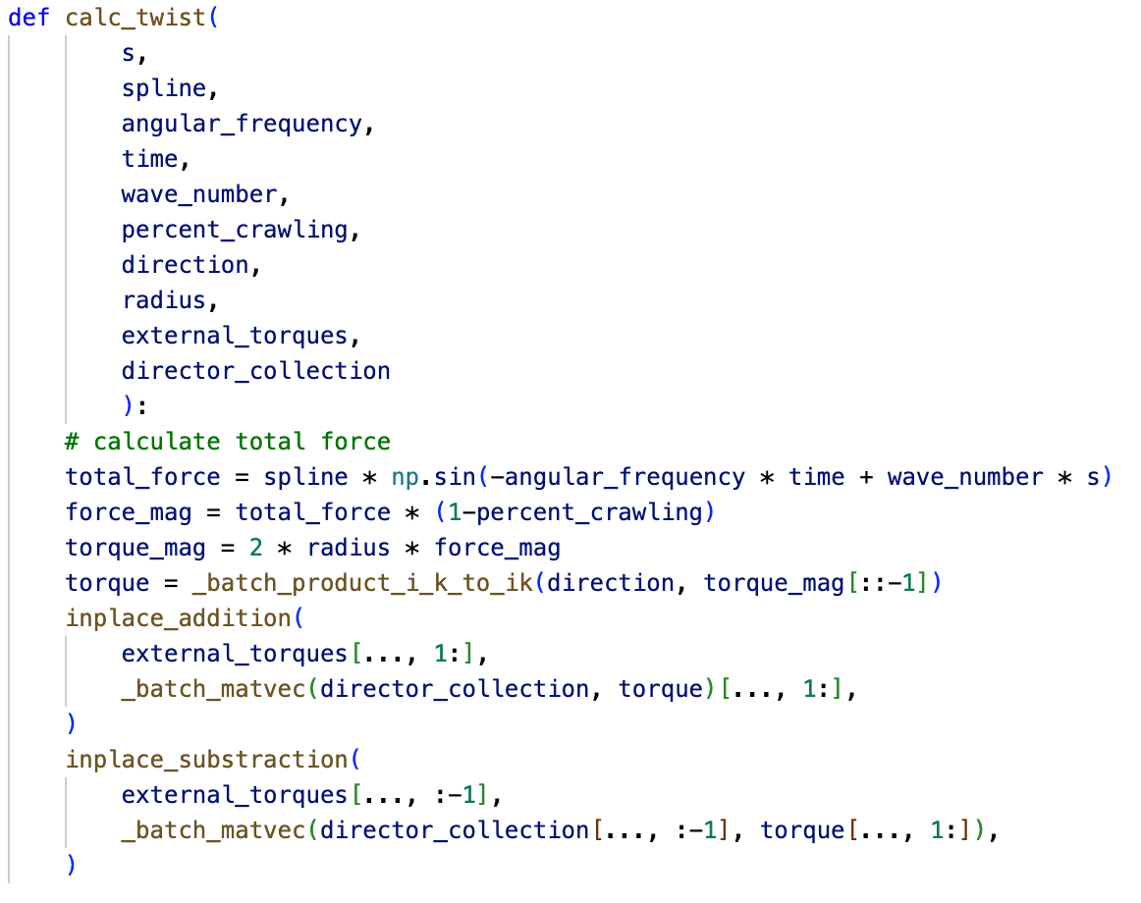
Snake force implementation
We defined twist force and stretch force as followed:

Slide 5
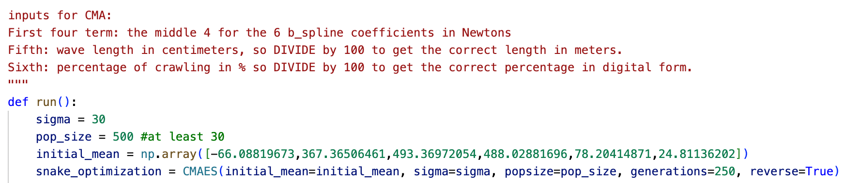
CMA input implementation
We used the same CMA algorithm as project 2 but with different parameters. Instead of using only the distance between the center of mass and mid point, we also consider the crawling percentage for this case. We used initial sigma as 30 with popsize as 500.

Slide 6
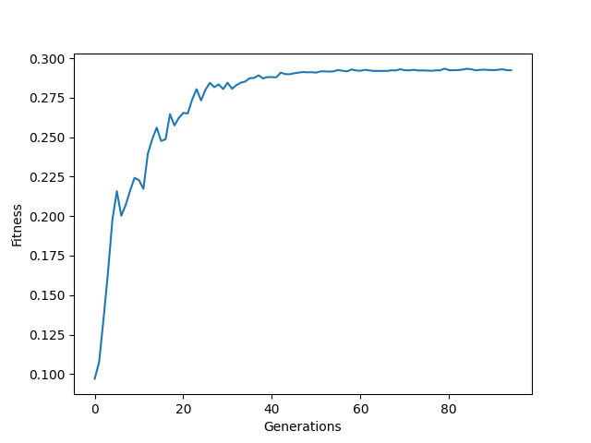
CMA Results Plot
Figure: CMA results fitness vs. generations for pure wiggling

Slide 7
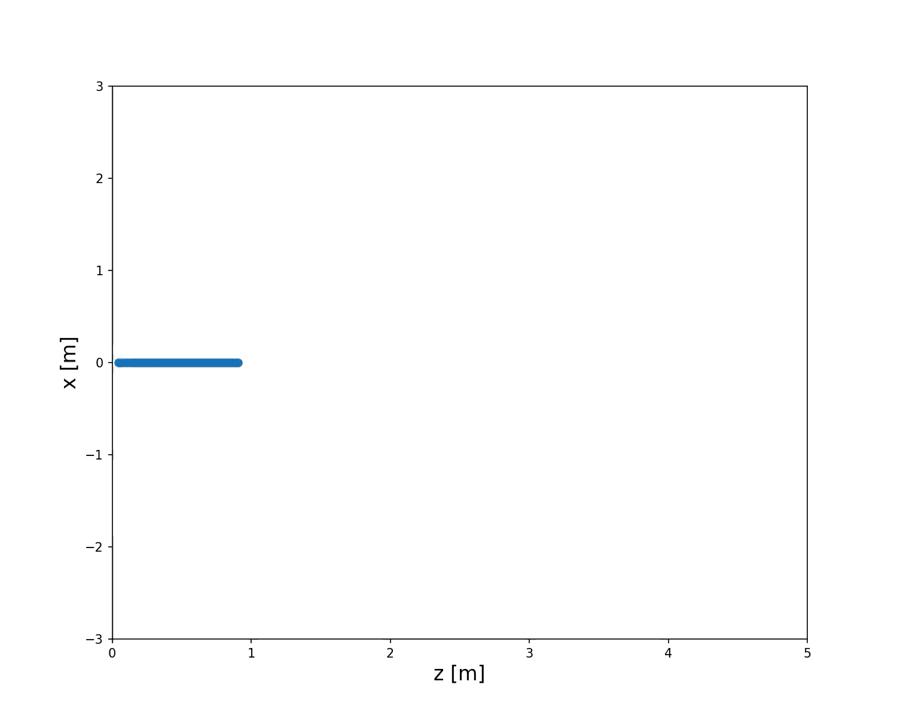
CMA Results Video
Video: CMA results fitness vs. generations for pure wiggling

Slide 8
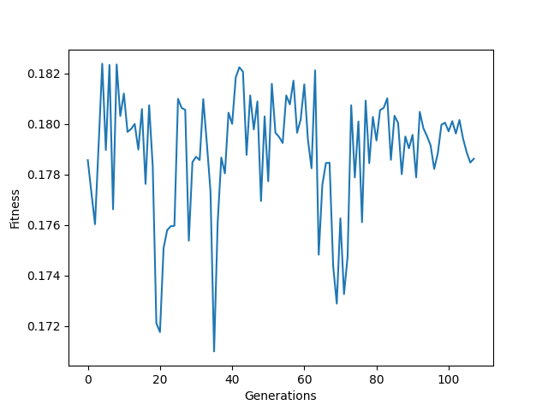
CMA Results Plot
Figure: CMA results fitness vs. generations for pure twitching

Slide 9
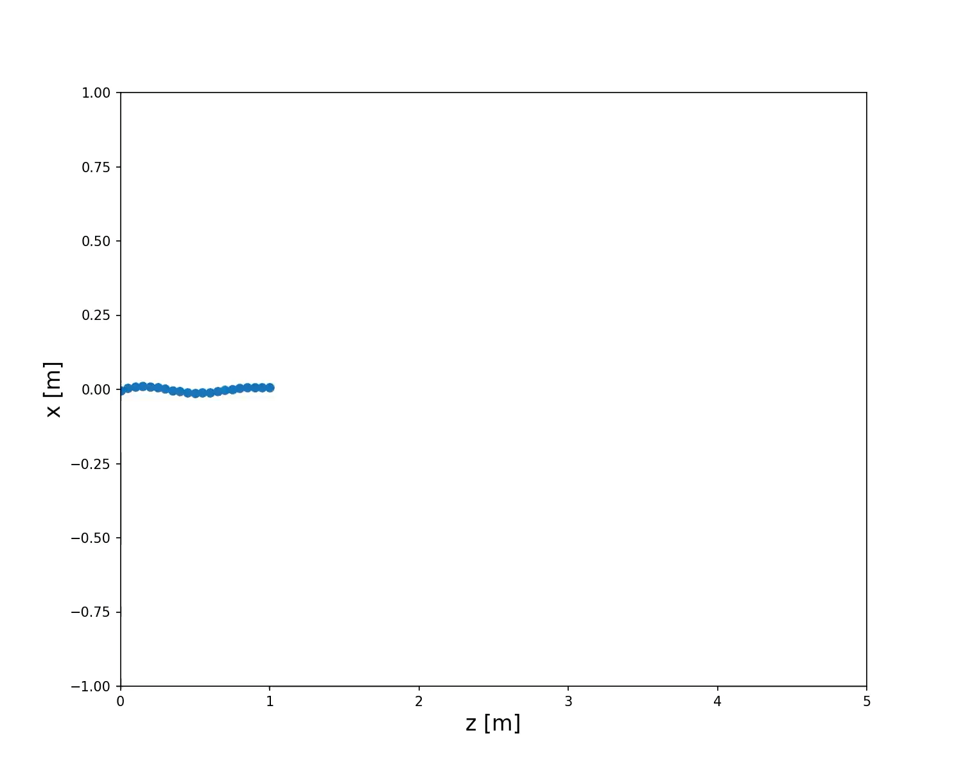
CMA Results Video
Video: CMA results fitness vs. generations for pure twitching

Slide 10
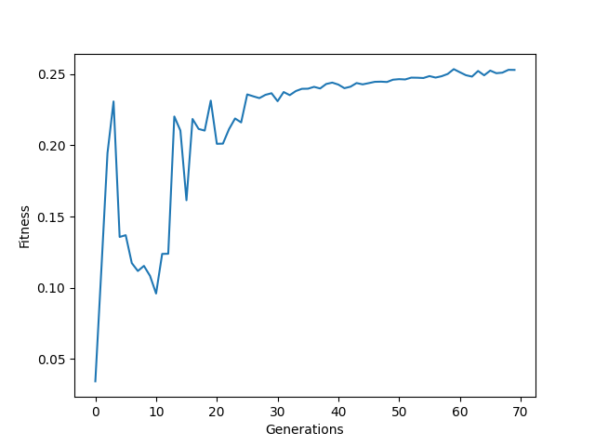
CMA Results Plot
Figure: CMA results fitness vs. generations for combined twitching and wiggling

Slide 11
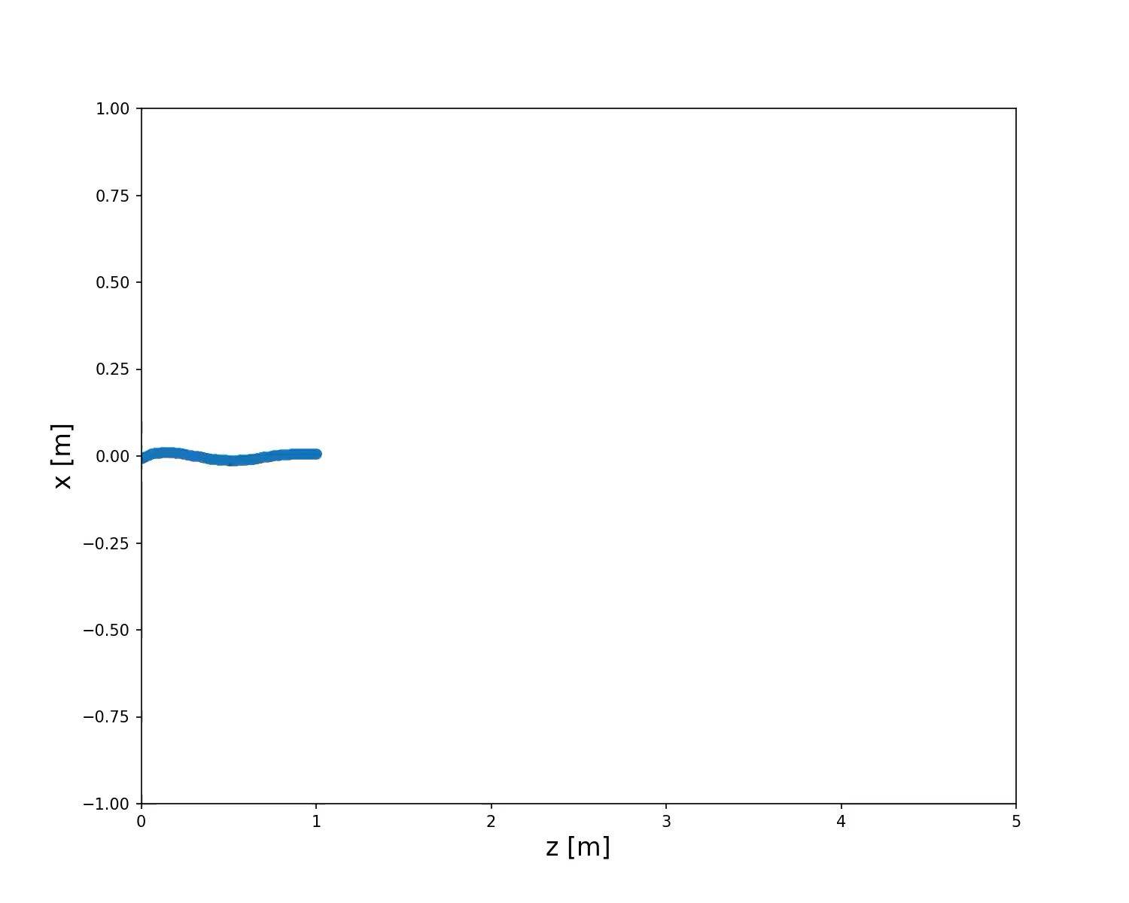
CMA Results Video
Figure: CMA results fitness vs. generations for combined twitching and wiggling

